Slide 1
HTML - Forms

Slide 2
HTML Forms are required when you want to collect some data from the site visitor
For example during user registration you would like to collect information such as:
Name
email address
credit card etc.

Slide 3
A form takes input from the site visitor and then will post it to a back-end application such as CGI, ASP Script or PHP script
The back-end application will perform required processing on the passed data based on defined business logic inside the application

Slide 4
The HTML <form> tag is used to create an HTML form and it has following syntax:
<form action=“script url” method=“GET/POST”>
.
.
.
</form>

Slide 5
form elements
There are various form elements available like:
text fields
textarea fields
drop-down menus
radio buttons
checkboxes

Slide 6
Form Attributes
action
Backend script ready to process your passed data
method
Method to be used to upload data. The most frequently used are GET and POST methods.
target
Specify the target window or frame where the result of the script will be displayed. It takes values like _blank, _self, _parent etc.

Slide 7
HTML Form Controls
There are different types of form controls that you can use to collect data using HTML form :
Text Input Controls
Checkboxes Controls
Radio Box Controls
Select Box Controls
File Select boxes
Hidden Controls
Clickable Buttons
Submit and Reset Button

Slide 8
Text Input Controls
There are three types of text input used on forms −
Single-line text input controls − This control is used for items that require only one line of user input, such as search boxes or names. They are created using HTML <input> tag
Password input controls − This is also a single-line text input but it masks the character as soon as a user enters it. They are also created using HTMl <input> tag
Multi-line text input controls − This is used when the user is required to give details that may be longer than a single sentence. Multi-line input controls are created using HTML <textarea> tag.

Slide 9
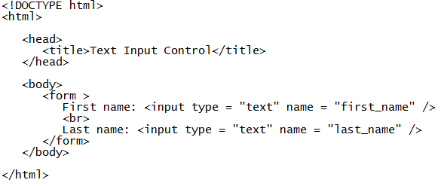
Single-line text input controls
This control is used for items that require only one line of user input, such as search boxes or names.
They are created using HTML <input> tag
e.g.:SingleLine

Slide 10
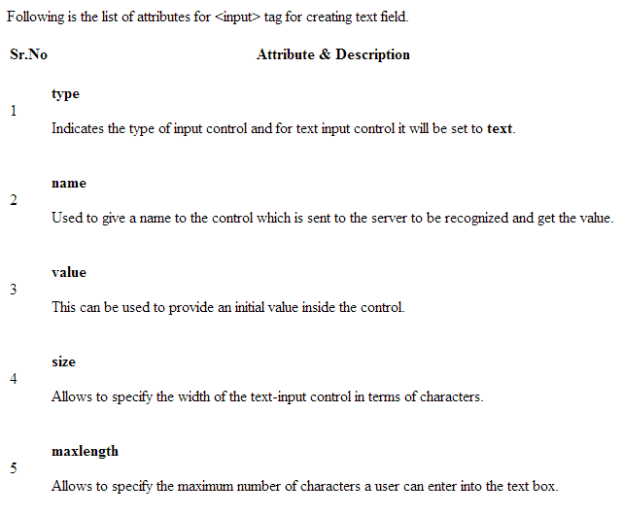

Slide 11
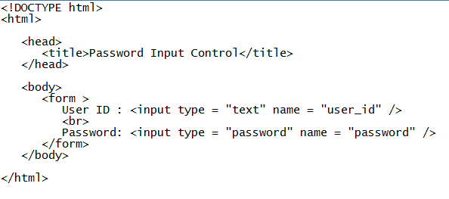
Password input controls
This is also a single-line text input but it masks the character as soon as a user enters it.
They are also created using HTML <input>tag but type attribute is set to password
E.g.: passwordInput

Slide 12
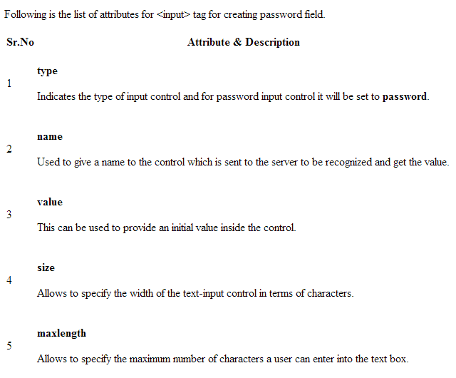

Slide 13
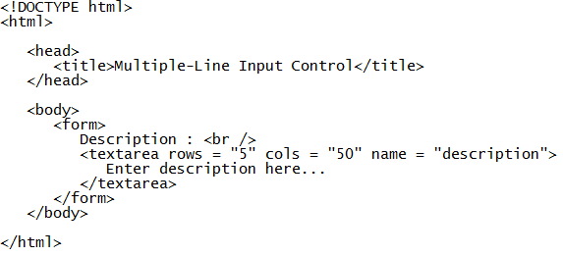
Multiple-Line Text Input Controls
This is used when the user is required to give details that may be longer than a single sentence
Multi-line input controls are created using HTML <textarea> tag
E.g.: multiLine

Slide 14
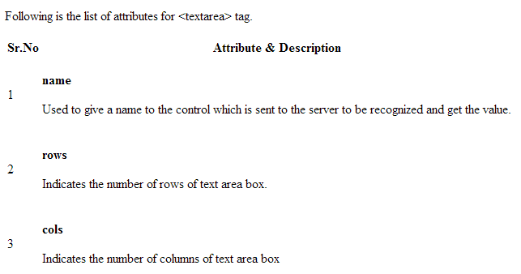

Slide 15
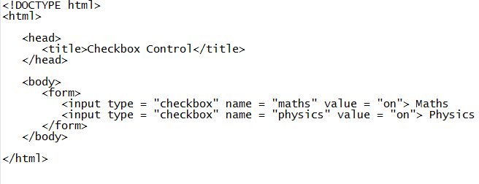
Checkbox Control
Checkboxes are used when more than one option is required to be selected.
They are also created using HTML <input> tag but type attribute is set to checkbox
E.g.: checkBox

Slide 16
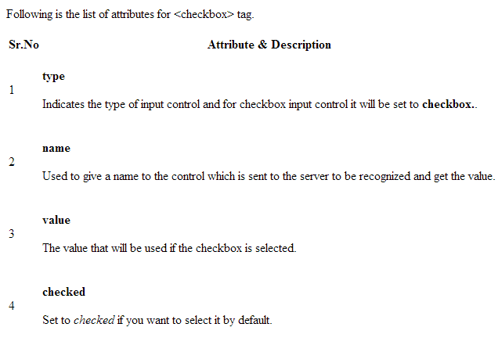

Slide 17
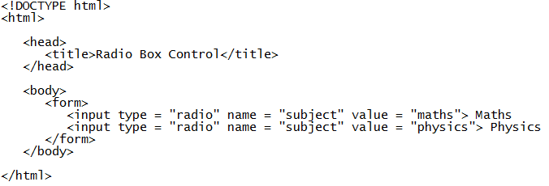
Radio Button Control
Radio buttons are used when out of many options, just one option is required to be selected.
They are also created using HTML <input> tag but type attribute is set to radio
E.g.: radioButton

Slide 18
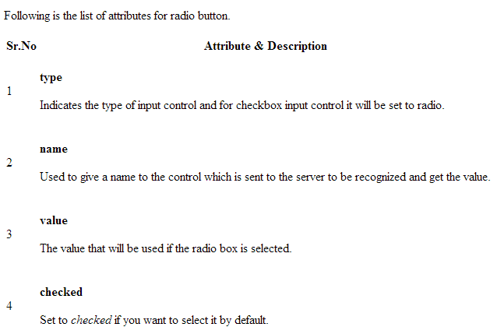

Slide 19
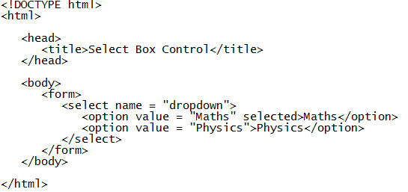
Select Box Control
A select box, also called drop down box which provides option to list down various options in the form of drop down list, from where a user can select one or more options
E.g.: selectBox

Slide 20
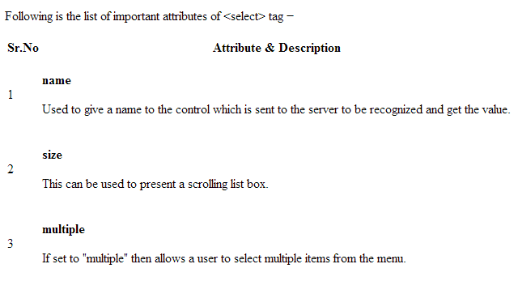

Slide 21
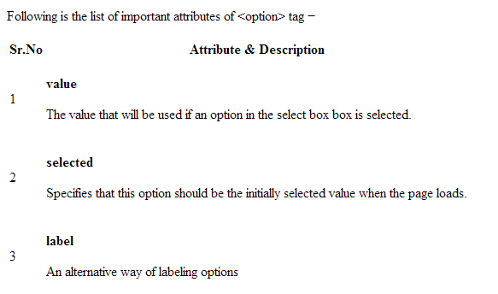

Slide 22
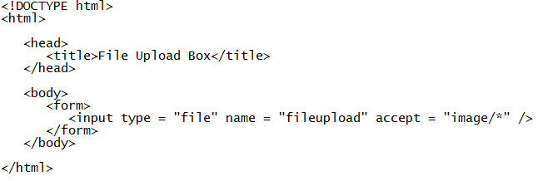
File Upload Box
If you want to allow a user to upload a file to your web site, you will need to use a file upload box, also known as a file select box.
This is also created using the <input> element but type attribute is set to file
E.g.: fileUpload

Slide 23
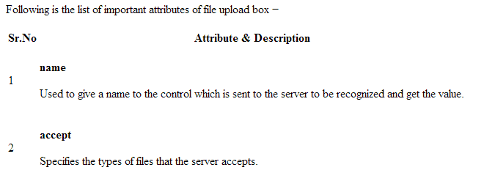

Slide 24
Attributes
Accept
The accept attribute specifies the types of files that the server accepts for file uploads.
It can only be used with <input type=“file”>
Audio/* - accepts all sound files
Video/* - accepts all video files
Image/* - accepts all image files
File_extension – File extension starting with the STOP character e.g .gif, .jpg, .doc, .pdf etc
To specify more than one value, separate with a comma( e.g accept=“image/jpeg, audio/*, video/*”)
<input type=“file" name="pic” accept=“image/*”>

Slide 25
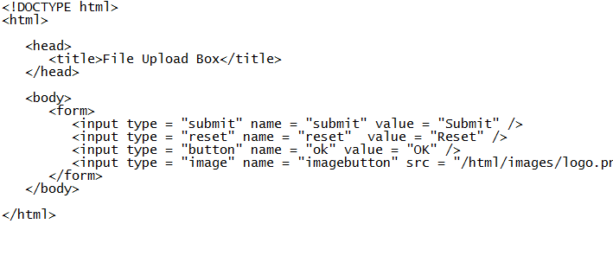
Button Controls
There are various ways in HTML to create clickable buttons.
You can also create a clickable button using <input>tag by setting its type attribute to button.
The type attribute can take the following values
E.g.: button

Slide 26
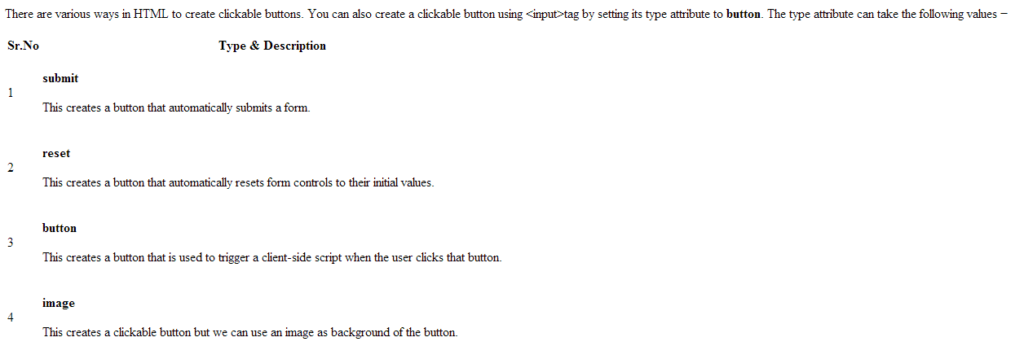

Slide 28
Datalist
<datalist> Element
The <datalist> element specifies a list of pre-defined options for an <input> element.
Users will see a drop-down list of the pre-defined options as they input data.
The list attribute of the <input> element, must refer to the id attribute of the <datalist> element.
<input list="browsers"> <datalist id="browsers"> <option value="Internet Explorer"> <option value="Firefox"> <option value="Chrome"> <option value="Opera"> <option value="Safari"> </datalist>

Slide 29
Fieldsets
Fieldsets are used to enclose a group of related form fields:
The <legend> is the fieldset's title.
<form method="post" action="form.php">
<fieldset>
<legend>Client Details</legend>
<input type="text" id="Name">
<input type="text" id="Phone">
</fieldset>
<fieldset>
<legend>Order Details</legend>
<input type="text" id="Quantity">
<textarea cols="40" rows="10" id="Remarks"></textarea>
</fieldset>
</form>

Slide 30
Number and Color
Number
defines a numeric input field. You can also set restrictions on what numbers are accepted.
Color
is used for input fields that should contain a color. Depending on browser support, a color picker can show up in the input field.
AGE (between 16 and 35): <input type="number" name="quantity" min="16" max=“55">
Select your favorite color: <input type="color" name="favcolor">

Slide 31
Date
Date
is used for input fields that should contain a date. Depending on browser support, a date picker can show up in the input field.
You can also add restrictions to dates.
Birthday: <input type="date" name="bday">
Enter a date before 1980-01-01: <input type="date" name="bday" max="1979-12-31"><br> Enter a date after 2000-01-01: <input type="date" name="bday" min="2000-01-02"><br>

Slide 32
Month and Week
Month
allows the user to select a month and year.
Week
allows the user to select a week and year.
Birthday (month and year): <input type="month" name="bdaymonth">
Select a week: <input type="week" name="week_year">

Slide 33
Time and Datetime-local
Time
allows the user to select a time.
Datetime-local
specifies a date and time input field, with no time zone.
Select your time: <input type="time" name="usr_time">
Birthday (date and time): <input type="datetime-local" name="bdaytime">

Slide 34
Range and Email
Range
is used for input fields that should contain a value within a range.
Email
is used for input fields that should contain an e-mail address.
Depending on browser support, the e-mail address can be automatically validated when submitted.
Some smartphones recognize the email type, and adds ".com” and “@” to the keyboard to match email input.
<input type="range" name="points" min="0" max="10">
E-mail:<input type="email" name="email">

Slide 35
Search and URL
Search
is used for search fields (a search field behaves like a regular text field).
Url
is used for input fields that should contain a URL address.
Depending on browser support, the url field can be automatically validated when submitted.
Some smartphones recognize the url type, and adds ".com" to the keyboard to match url input.
Search Google: <input type="search" name="googlesearch">
Add your homepage: <input type="url" name="homepage">

Slide 36
Input Attributes
First name:<br> <input type="text" name="firstname" value=“Suhail">
Value
The value attribute specifies the initial value for an input field.
The value attribute is used differently for different input types:
For "button", "reset", and "submit" - it defines the text on the button
For "text", "password", and "hidden" - it defines the initial (default) value of the input field
For "checkbox", "radio", "image" - it defines the value associated with the input (this is also the value that is sent on submit)
Note: The value attribute cannot be used with <input type="file">.

Slide 37
Readonly
The readonly attribute specifies that the input field is read only (cannot be changed).
Disabled
The disabled attribute specifies that the input field is disabled.
A disabled input field is unusable and un-clickable, and its value will not be sent when submitting the form.
First name:<br> <input type="text" name="firstname" value=“Iliya" readonly>
First name:<br> <input type="text" name="firstname" value=“Shehu" disabled>

Slide 38
….
Size
The size attribute specifies the visual size (in characters) for the input field.
maxlength
The maxlength attribute specifies the maximum allowed length for the input field
First name:<br> <input type="text" name="firstname" value=“Dogo“ size=“40”>
First name:<br> <input type="text" name="firstname" value=“Shehu“ maxlength=“10”>

Slide 39
….
Height and width
The height and width attributes specify the height and width of an <input type="image"> element to serve as a submit button.
autofocus
The autofocus attribute specifies that the input field should automatically get focus when the page loads.
<input type="image" src="img_submit.gif" alt="Submit" width="48" height="48">

Slide 40
….
pattern
The pattern attribute specifies a regular expression that the <input> element's value is checked against.
For example the input field that can contain only three letters (no numbers or special characters).
Country code:
<input type="text" name="country_code" pattern="[A-Za-z]{3}" title="Three letter country code">

Slide 41
….
required
The required attribute specifies that an input field must be filled out before submitting the form.
Username: <input type="text" name="usrname" required>

Slide 42
HTML Forms – Design Tips
Before starting to code, it's always better to step back and take the time to think about your form.
Designing a quick mockup will help you to define the right set of data you want to ask your user.
From a user experience point of view, it's important to remember that the bigger your form, the more you risk losing users.
Keep it simple and stay focused: ask only for what you absolutely need. Designing forms is an important step when you are building a site or application.

